Slide 1


TWEFS ENTERPRISE
Employee data analysis
Presented by: Chime Stephanie, Odewusi Kolawole, Faith Umoren, Tony Gaga and Akinpelu Elizabeth
Strategic Workforce Insight and Recommendations

Slide 2
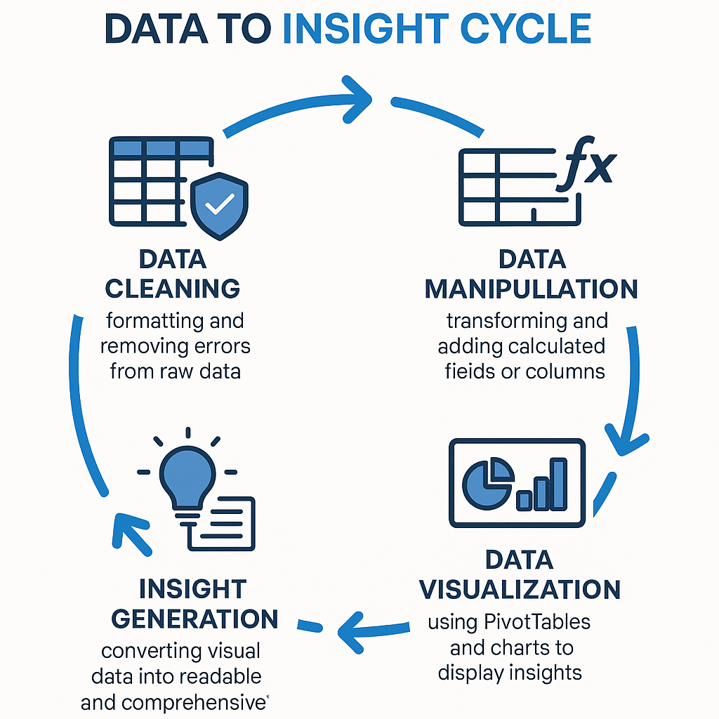

Slide 3

Introduction
This presentation gives a detailed analysis of employee related metrics across departments. Using data visualization, we explored salary distribution, project completion rates, performance scores, and satisfaction levels. With this we uncovered actionable insights that can guide strategic decisions in workforce management, resource allocation, and performance optimization.
By identifying departmental strengths and gaps, this report serves as a foundation for enhancing operational efficiency and driving employee engagement.

Slide 4

Objectives
Understand employee distribution across departments
Analyze salary, performance, and satisfaction by department
Identify which teams complete the most projects
Explore the link between tenure , performance and departments
Understanding if age is a factor for efficiency and experience
Spot areas needing improvement in workforce efficiency
Provision of recommendation and actionable steps that help improve
employment engagement and performance

Slide 5
Insights
1. Departmental Performance & Contribution
HR leads in both project completion (327 total) and average performance score (3.24) — indicating a highly efficient and effective department.
Marketing accounts for the largest workforce (27%) and the highest salary cost ($386.2K), contributing the second-highest in projects (293).
IT has the lowest performance score (2.45) despite high salary allocation ($268.9K) and moderate workload.
Sales is persistently at the bottom across metrics: lowest employees (15%), projects completed (228), salary ($202.2K), and work hours (890 hrs).

Slide 6
Core Insights
2. Age Group Trends
50-60 age group has the highest productivity: 481 projects, average performance 3.16, and satisfaction 0.75 — making them the most effective age segment.
40-49 age group shows lowest performance (2.60) and satisfaction (0.71), suggesting potential disengagement or misalignment.
20-29 age group shows promising signs in Finance (highest performance score 3.75) but lowest satisfaction in Marketing (0.66).
30-39 age group exhibits a balanced but unremarkable performance across all metrics, suggesting a plateauing effect.

Slide 7
Core Insights
3. Tenure-Based Performance
6–7 years tenure shows the highest performance (3.10), proving that longer employee retention correlates with better output.
2–3 years tenure remains lowest in performance (2.80) across all groups, hinting at a potential onboarding or training gap.
4. Employee Satisfaction
HR leads in satisfaction (0.75–0.82), reinforcing the importance of work environment in driving productivity.
Marketing, despite its size and resource allocation, has lowest satisfaction (0.64–0.71) — a red flag.

Slide 8
Key Problems Identified
Underperformance of High-Spending Departments
  Marketing receives the highest salary allocation but underdelivers on employee satisfaction and performance.
  IT shows low performance despite high investments and workload.
Sales Department Performance Crisis
  Consistently the lowest across all major KPIs — needs urgent intervention in motivation, training, or structure.
Youth and New Tenure Performance Gap
  Newer employees (2–3 years) and younger staff (20–29) underperform, suggesting gaps in onboarding or support.
Workload Imbalance
  Some departments (e.g., Marketing, IT) carry significantly heavier workloads, which may contribute to burnout and lower satisfaction.

Slide 9
Strategic Recommendations
Short-Term Fixes
Employee Engagement Surveys in Marketing and IT to uncover causes of dissatisfaction and stress.
Performance Audits in Sales to identify skill gaps, operational bottlenecks, and leadership weaknesses.
Onboarding Overhaul for employees under 3 years tenure — implement mentorship, performance incentives, and upskilling.
Redistribute Projects to ease workload from Marketing and IT; HR can absorb more given its consistent high performance.

Slide 10
Strategic Reccomendations
Long-Term Strategy
Retention Plans for 6–7 Year Tenure Group: Create leadership pipelines and incentives to retain top performers.
Age-Specific Coaching: Boost productivity in 40–49 age group through targeted engagement and reskilling.
Departmental Rebalancing: Consider shifting resources from underperforming departments to those yielding better ROI (e.g., from Sales to HR).
HR as a Model: Replicate HR’s best practices across departments—especially in training, satisfaction, and performance management.

Slide 11
Conclusion
The TWEFS workforce landscape reveals a mismatch between resource allocation and productivity, especially in Marketing, IT, and Sales. In Addition, HR demonstrates a benchmark model with high satisfaction, high output, and strong leadership. Age and tenure factors play a critical role in driving performance — emphasizing the need to focus on both retention and structured onboarding.
With targeted improvements in employee engagement, training, and workload distribution, TWEFS can drive a more balanced, high-performing, and satisfied workforce, maximizing both ROI and human capital value.

